Slide 1
SAI Music Category
Jo and Vicky

Slide 2
Music Category – the basics
The primary focus of the music category is the performance of a song.
The music category is split into:
Song and arrangement (0-30 points)
Performance (0-70 points)

Slide 3
Music Category
The music judge rewards a performance when:
The song and arrangement are accurately performed and within the vocal capabilities of the chorus.
The musical performance is appropriate to the lyrics, to the harmonic and rhythmic content, and to accepted standards of musical artistry in the barbershop style.
The song is lyrically and melodically appropriate to the barbershop art form and has been arranged with harmonization and voicing consistent with the characteristics of the barbershop style.

Slide 4
Music Category
Any song can be arranged in the barbershop style, but it should adhere to the following characteristics:
chord structure
arrangement
tuning
delivery
interpretation
the cone-shaped sound (keeping it balanced)
These are integral factors which contribute to the “lock and ring” characteristic of the barbershop style.

Slide 5
Song and Arrangement (0-30 points)
A song is the combination of lyrics, melody, and harmony.
A typical composition includes:
an introduction - sets the scene musically and/or lyrically
a verse - provides additional musical and lyrical preparation for ‘the story’
a chorus - the only element that is always present and is ‘the story’
a tag - a musical coda (brings the music to an end)

Slide 6
Song and Arrangement (0-30 points)
Lyrics
Similar to the words of a poem
Convey the message of the song
Should have rhyming structure
In Barbershop:
Each syllable has its own note
The message of the song has a high-point that builds up to the punch-line of ‘the story’.

Slide 7
Song and Arrangement (0-30 points)
Arrangement
This consists of:
Form – single song arrangements and medleys
Melody – which in barbershop is:
singable
musically interesting
has a high point that coincides with the climactic point of the lyrics.

Slide 8
Performance (0-70 points)
Vocal Skills
affect the performance in these areas:
Chord accuracy (relates to vertical tuning of the chord)
Chord clarity (is it easily identifiable to the judge)
Section unity (are all singers in a section singing with matching sound)
Tuning (training the ear)
The chorus level of vocal skills can also enhance or detract from the planned phrasing and dynamic levels.

Slide 9
Performance (0-70 points)
Harmony Accuracy
can only be achieved with the following:
Correct notes - all members of the chorus should sing the correct notes in all four voice sections
Fine tuning – tuning is paramount for chords to lock and ring

Slide 10
Performance (0-70 points)
Barbershop Style
The performer is the channel through which the following is required:
Appropriate tempo - the speed or pace at which music is performed.
Musical unity - singing vowels correctly and singing chords in tune simultaneously.
Musical phrasing - a division of the musical line, like a sentence in a poem.
Dynamics - the variation in volume levels within the performance.
Musical energy - that special ingredient designed to provide additional satisfaction for both listener and performer.

Slide 11
Performance (0-70 points)
Musical Artistry
The planned performance which is a combination of:
tempo, rhythm, phrasing, and dynamics
Is effective only when the performer adds “heart” to the delivery.
True expression (living the words you sing) is an integral part of an artistic performance.
The music judge seeks a performance that demonstrates an artistic, energized projection of tone, whether that tone be full and joyous, lightly whimsical or deeply emotional.

Slide 12
Performance (0-70 points)
Musical Artistry
The ultimate in musical performance is achieved when the performer:
reaches out at the beginning of the performance
takes the audience in the palm of their hand
holds them there until the performance has concluded
keeps each listener totally spell-bound by the emotional impact achieved
Musical artistry is when the performer has the freedom to present a magical experience that is aesthetically satisfying and memorable for both performer and listener.

Slide 13
Performance (0-70 points)
Suitability to performer
The music judge evaluates:
the relative suitability of the song/arrangement to the chorus.
the vocal capabilities of the chorus
the skill demonstrated in performing the arrangement
The singers should be able to execute their lines accurately and demonstrate vocal ranges sufficient to handle the extreme highs and lows while remaining in balance (connects to the sound category).
The performers should demonstrate vocal energy, support and musical stamina to handle the phrasing, dynamics and musical characterization required to convey the interpretive plan effectively.

Slide 14
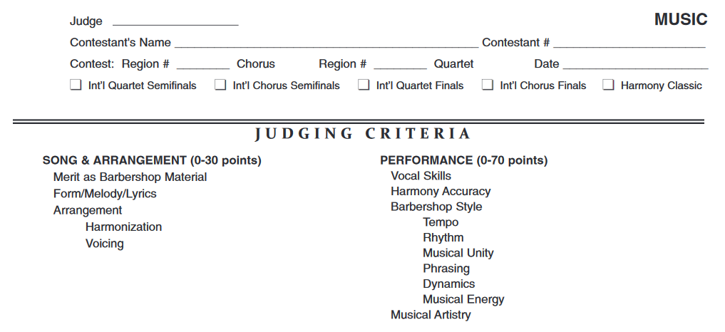
Judging criteria

Slide 15
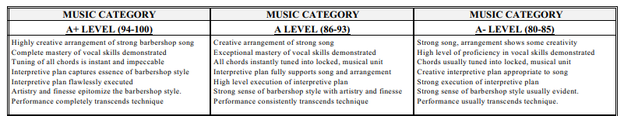
Judging criteria
Lace City Chorus Scores in the Music Category in 2017:
I Have Dreamed 82 points (A-)
I Got Rhythm 85 points (A-)
Category Total 167 points (A-)

Slide 16
Judging criteria
Lace City Chorus Music Category comments:
Song and Arrangement (0-30 points)
Merit as barbershop material, form/melody/lyrics, arrangement, harmonization and voicing
“Yes, both are strong arrangements. Song 2 is busy but well handled”
Performance (0-70 points)
Vocal skills - “Very well skilled”
Harmony Accuracy - “Solid as a rock”
Barbershop Style (Tempo, Rhythm, phrasing, dynamics) - No specific comments
(Musical unity and musical energy) - “Minor inconsistencies”
Musical Artistry - “Solid as a rock”
Suitability To Performer
Song 1 “Yes”
Song 2 “Yes”

Slide 17
Judging criteria
Lace City Chorus Music Category comments:
Performance Evaluation
Song 1
“Gentle beginning to this ballad – keep it totally unified – synch errors here and there inhibit chord clarity.
Vocal inflections are both creative and compelling.
Vocal energy becomes more consistent after the bridge, then wow – the unit comes to a higher level.”
Song 2
“Unify the intro – synch errors made things a bit unclear.
Driving energy and tempo becomes relentless.
Counter melodies well done.
Post was a long (next word illegible) note to hold and then the chords wrapped it up.”

Slide 18
Any Questions?
Thank you for listening

