Slide 1
Vocal Rehab May 2021
Getting our voices in shape
Alyson Chaney
alysonchaney@yahoo.co.uk

Slide 4
First things first
Always strive to sing with a freely produced sound
Sing often! Sing daily!

Slide 5
Wake up your breathing!
Three things : capacity, support, management
Bubbling without pitch (“blowing a raspberry!”)
Inhale, suspend, exhale
Hissing to 20, then double time (this is a great workout!)

Slide 6
Semi-occluded vocal tract exercises (SOVT)
The BEST way to keep your voice in shape
Humming, NG sirens, bubbling, ZZZZ, VVVV, and the best of all : Straw Phonation

Slide 7
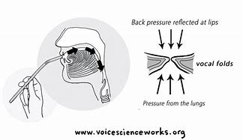
Why Straw Phonation?
It’s such a great vocal exercise because during straw phonation there is less impact, collision, and stress on the vocal folds.
Use a straw with a fairly thin bore.
Have a glass or a bottle of water which is less than half full. Submerge your straw 5 cm approx. below the surface of the water for best results.
Ensure your air flow is such that the water bubbles in a controlled way. No water volcanoes!
Can be equally effective without the water!
Notes:
Like doing aqua aerobic exercises – less stress on the muscles but still the same impact.

Slide 8
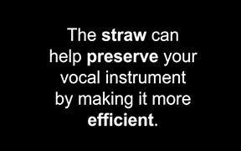
Straw Phonation
Sustain sounds
Pitch glides (“sirens”) – both ascending and descending
Engine sounds (5-6 “hills” with varying dynamics)
Using the melody of songs
Alternative : use a disposable cup.
SOVT Exercises - VoiceScienceWorks

Slide 9
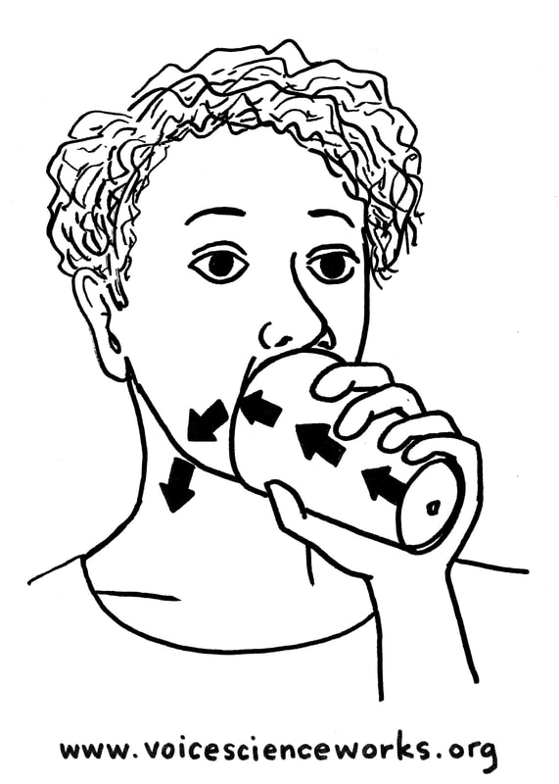
Cup phonation
Advantage is that you can sing vowel sounds and, of course, the words of a song using this method.

Slide 10
Vocal Function exercises
Designed by speech and language pathologists to help strengthen a voice which has been weakened through misuse or illness
Warm up using vowel EE on F above middle C (or if you’re a bass the F below middle C). Produce with good respiratory support and resonant focus.
Stretch – glide from lowest to highest note on O vowel (use “knoll”)
Contract – glide from highest to lowest note on O vowel ( use “knoll”)
Power – sustain the musical notes C-D-E-F-G for as long as possible on O vowel (use “old” without the D)
All of the above exercises should be achieved on a soft dynamic
Vocal+Function+Exercises.pdf

Slide 11
To sum up……..
Sing every day. If you haven’t sung for a while begin with gentle humming and NG. Simple scales or easy songs on these sounds.
Use a song that the chorus is currently rehearsing and bubble through the entire song. This will be a great workout.
Straw phonation exercises – also great for cool down.
Vocal function exercises
Read out loud. Reading purposefully helps keep your voice active and builds up endurance. Poems are good. I use “A Nature Poem for every day of the year” (Batsford) – great book!
Move your body! Do some cardiovascular exercise at least three times a week where you get your heart rate elevated for approximately 30 minutes. This can be as simple as brisk walking or dancing to some fun music. This will greatly improve vocal stamina.

Slide 12
More resources
Sing Baby Sing (SA members only) Sing Baby Sing Downloads | Sweet Adelines
Kim Newcomb : NewVoice Studio – YouTube
Kathleen Hansen (plus cat!) – has lots of short vocal lessons on youtube – here’s one demonstrating vocal function
REVIVE your VOICE! Vocal Function Exercises (Stemple) - Bing video

Slide 13
Last words………
On practice :
“It’s not magic – you just have to put in the work”.
Joyce DiDonato, mezzo-soprano

