Slide 1
Visual Communication Category
14/07/21

Slide 2
Showmanship → Visual Communication
The visual communication judge watches and listens to a performance evaluating the degree of communication established with the audience.
Notes:
EB - To evaluate the communication established with the audience. That’s the goal, to establish great communication.
The change in name to Visual Communication was felt to be a clearer indication to the world that what judges are concerned with is how the music is communicated to the audience through visual means.
For some, the word “showmanship” connotes “flash” and insincere performance. The goal is for an authentic, genuine performance that impacts an audience. In the judging book it said ‘salesmanship’ this implies enforced rather than communicated and offered.
It came about after a project that looked at what the misunderstandings are within the category, how have things evolved from the performer and audience perspective.

Slide 3
“The ultimate goal of any barbershop performance is the communication of music. The three other scoring categories address the quality and artistry of the musical product, while the visual communication category assesses the quality and artistry of the visual product.”
Judging category description book - category introduction
Communication
Artistry
Notes:
HA This is the introduction from the judging description for VC. Paragraph 1. Not the words communication and artistry

Slide 4
“Studies have demonstrated that the majority of communication is processed and received through visual elements; for this reason, the ability of performers to visually express the emotion, story, and message of a song is a significant part of successful connection with an audience.”
Judging category description book - category introduction
Emotion
Story/message
Connection
Notes:
HA This is the introduction from the judging description for VC. Paragraph 2. Note the words emotion, connection, story message

Slide 5
“Ideally, visual communication enhances and supports the music authentically and naturally, so that these elements are intertwined and inseparable to create a total entertainment experience. With effective visual communication, the performer is able to enhance what the listener hears by reinforcing it with what the viewer sees.”
Judging category description book - category introduction
Authentically
Naturally
Notes:
HA This is the introduction from the judging description for VC. Paragraph 3 – note naturally and authentically.
There’s no mention of costumes, make up, being showy, it’s all about a holistic, natural performance.

Slide 6
Score weighting
Showmanship = Preparation (30%) and Performance (70%)
Visual Communication = a holistic category, taking into account all elements of the category, with each song worth a possible 100 points.
Language
Gender neutral
Culturally neutral
Positive language
Clearer – especially if English is a 2nd language
Notes:
EB Showmanship – 70 – 30 split - based on the scoresheet and the directives in the Showmanship category, the judges are to assess each song with this split weight.
VC – 100% holistic approach - In this way, preparation elements such as costumes and makeup are not perceived to be given greater weight or signiﬁcance over all the elements of the category.

Slide 7
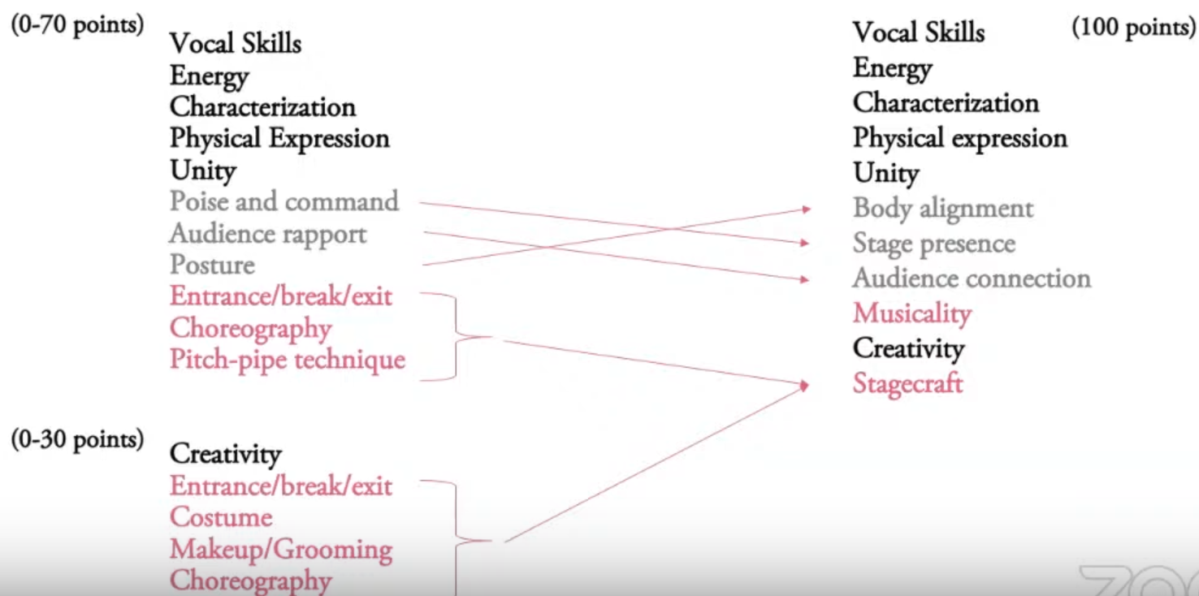
Judging criteria elements
Notes:
HA
Some of the elements listed on the Showmanship scoresheet were renamed and re-organized in an eﬀort to better guide our members in understanding what the Visual Communication judges value most in the performances at competitions.
Kept 6 of the elements – these are in bold. = the characterisation must bring the song off the page and bring it to life for the audience.
Unity - is the group performing as a single entity.
Energy is the life force of a performance. It’s an unseen element that transports the performance from the stage to the audience.
Re-named some elements for greater clarity and speciﬁcity:
Body Alignment (formerly posture) – felt controlled where as alignment is more free and open
Stage Presence (formerly poise and command) – poise and command felt rigid/stiff – military like. We’re now looking for a free and open expression. Not just confidence.
Audience Connection (formerly audience rapport) – similar thing, but changed to be more communicative and open like a 2 way thing.
Added new element:
“Musicality” which refers to the artistic, authentic visual expression of a musical performance – make it all come alive. This is the element that most excites the judges.
Created “Stagecraft”:
Stagecraft is the term which will serve as the umbrella for all the TOOLS we use for visual communication.
Under this overarching heading fall choreography, costume, makeup, hairstyles, props, and non-singing moments.
In addition, entrance/break/exit and pitch pipe technique are now a subset of “non-singing moments.”
New tools added include staging, stage decoration, and lights.
Under General Considerations:
To allow for more creativity and freedom, the language surrounding the wearing of a crown during a Sweet Adelines performance has been modiﬁed.
Same attention is demanded of the vocal skills, but we have added musicality which is what makes the performance enguine and believable and authentic. It’s a state of being rather than a skill. To create musicality you need to trust your ability to open up yourself, your heart to portray genuine performance.

Slide 8
Notes:
HA Scoring feedback will be largely the same, just with the new structure of the category.
Since the adjudication is now a holistic 100%, there is no breakdown of the elements into two columns. Instead, all the elements to be considered are in one column at the top of the scoresheet.

Slide 9
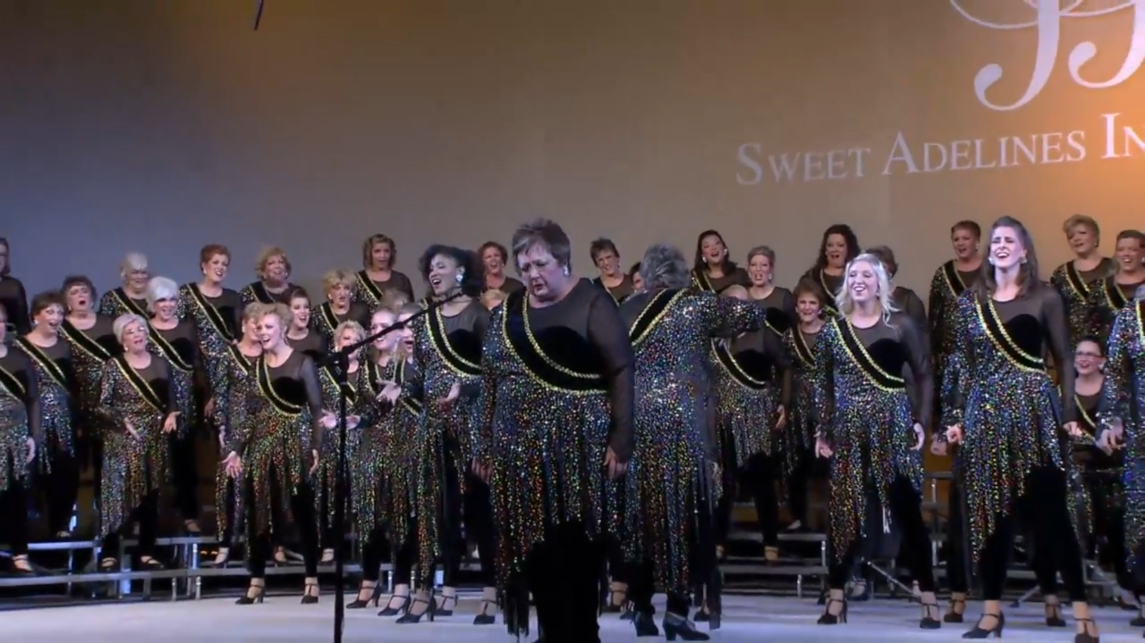
https://www.youtube.com/watch?v=yHbrjsuo8UY
https://www.youtube.com/watch?v=xxDxzGX7HX8
Notes:
EB play, Helen lead discussion.
Let’s watch a few great examples.
The first is Rich Tones from the 2018 chorus final. WATCH from start for 2 min
What do you think?
It’s not perfect, it’s not the best solo singing the judges will have heard, but it was most definitely from the heart.
Ronninge, from 2019 semi final. Watch from 1min 30 for a minute or so. Contest ballad.
What do you think?

Slide 10
What does this mean for us?
Can we be ourselves more so than before?
Will it be more fun?
Will it help our singing?
How much do we need to “change” what we do?
Notes:
EB: so what does this mean for us? Here are some thoughts you might be having.
You’ll have chance to discuss these in groups in a few moments.

