Slide 1
Disordered Breathing
Nicky Mills
Clinical Specialist Physiotherapist

Slide 2
Aims
Normal breathing pattern
Disordered breathing pattern
How to recognise and correct a disordered breathing pattern
Considerations for singing

Slide 3
Case Study
42 year old woman
Referred for respiratory physiotherapy assessment with increasing shortness of breath
Sings in a band, increasingly struggling with singing due to shortness of breath and weak voice
All heart and lung tests normal

Slide 4
Case Study
On assessment
Shortness of breath (SOB) on exertion main problem
Unable to build her fitness even with regular exercise
Struggling to complete longer lines when singing
Struggling to project voice when singing
Sore throat after singing
All problems with singing worse with gigs
Throat clearing all day on and off, dry irritable cough after a lot of singing
  Chest pain, dizzy, light headed, headaches, palpitations, blurred vision, abdominal bloating, numbness in lips and both hands, thoracic spine, chest and lumbar spine pain, stressed, low in mood, tearful

Slide 5
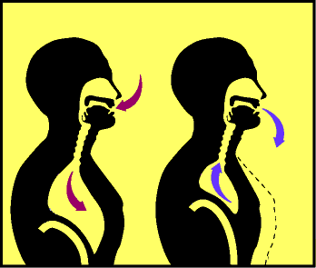
NORMAL
BREATHING

Slide 6
Normal breathing at rest
10-14 breaths/minute in and out through the nose
Nose provides 2/3 airflow resistance and controls airflow velocity
Inhalation – 80-90% diaphragm, minimal upper chest wall movement
Exhalation – passive
Upper chest wall relaxed with minimal movement
Slow, regular, nasal, diaphragmatic, invisible, inaudible, unconscious
Important to consider what is a normal breathing pattern for any given person with chronic respiratory or cardiac disease
Notes:
no panting, no wheezing, no sighing, no yawning, no sneezing, no coughing, no deep inhalations or exhalations

Slide 7
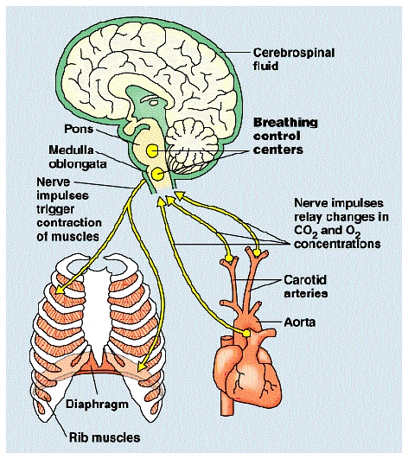
Control of normal breathing
The respiratory centre in the brain maintains normal oxygen and carbon dioxide levels
It monitors pH levels and keeps it within normal limits
Carbon dioxide levels main driver for breathing
Notes:
Ventilation controlled according to the body’s metabolic requirements
Breathing of healthy people at rest mainly regulated by pre-set normal chemical CO2 concentrations
Central chemoreceptors (respiratory centre, medulla oblongata) detect changes in the Ph of CSF caused by changes in blood CO2 levels.
Peripheral chemoreceptors (carotid and aortic bodies) detect changes in blood Ph
Central chemoreceptors are located on the ventrolateral surface of the medulla oblongata
CO2 diffuses across the blood-brain barrier from blood to cerebral spinal fluid (CSF) while H+ and HCO3- are unable to
As the blood CO2 readily passes the blood-brain barrier into the CSF it will react with H2O to make H2CO3, that will split into HCO3- and H+.
CO2 + H2O → HCO3- + H+
An increase in H+ concentration will directly stimulate the chemoreceptor neurons in the medulla oblongata. They will relay this information and cause an increase in alveolar ventilation which will lead to a decrease in CO2.
The central chemoreceptors are responsible for ~80% of the response to CO2 concentration

Slide 8
Factors affecting normal breathing
Resp
Centre
Exercise
Relaxation
Gender
Musculo-
Skeletal
System
Diet
Pain
Sleep
Emotions
Talking/singing
Eating

Slide 9
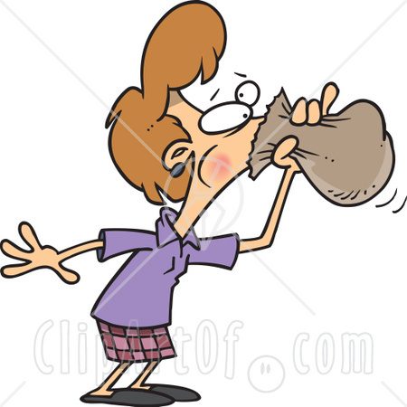
ABNORMAL
BREATHING

Slide 10
Terminology
1800’s Da Costa’s Syndrome
/Soldiers heart
1900’s Effort syndrome
1960’s Disproportionate
Breathlessness /
Behavioural
Breathlessness
1970’s Hyperventilation
2000’s Dysfunctional
Breathing
2010’s Disordered
Breathing/
Pattern Disordered
Breathing
Disordered breathing
Dysfunctional breathing
Breathing pattern disorder
Disorganised breathing
Hyperventilation
Hyperventilation syndrome
(Panic attack)
= Over breathing

Slide 11
Disordered breathing
“A pattern of over breathing where the depth and/or rate are in excess of the metabolic needs of the body at that time…Physical, environmental or psychological stimuli override the automatic activity of the respiratory centres, which are tuned to maintain arterial CO2 levels within a narrow range”
(Chaitow et al 2002)
In some people respiratory centre sensitivity reset to lower pCO2/higher pH chronically (Nixon 1993)

Slide 12
Sympathetic NS symptoms
Neurology – Headache, numbness/ tingling, dizziness, tremor/ataxia, blurred/ tunnel vision, anxiety/panic, hallucinations, sleep disturbance, nightmares
Cardiovascular – Chest pain, angina, palpitations, fast heart rate, light headed, fainting, ECG changes
Muscular – Aching, stiffness, cramps, spasm, tetany
GI – Heartburn, bloating, dry mouth, belching/excess wind
Skin – Sweating
Respiratory – Chest tightness, throat tightness, loss of voice projection
(Chaitow et al 2002)
Notes:
Neurology - Cerebrovascular constriction, neuronal excitability from alkalosis or hypocalcaemia
Hypocapnia decreases blood flow to the brain (2% for every 1mm Hg drop) – a typical hyperventilation episode can cause approx. 25% less O2 to brain
↓ Concentration
↓ Short term memory
Tunnel vision
Migraine type headaches
irregular nature of dys br causes fluctuating alterations in acid-base balance more drastic neurological consequences (Lun 1981)
Cardiovascular– reduced coronary blood flow Altered excitability of SA and AV nodes and myocardium, reduces cardiac out put and blood pressure from peripheral vasodilation. ECG changes ST depression, elevation and prolongues QT interval, sometimes T wave inversion
Muscular- motor nerve hyper excitability, weakness due to fatigue,
GI – Air swallowing, mouth breathing, decreased tone gut wall

Slide 13
Disordered breathing
Mouth breathing
Frequent sighs
Variable pattern
Noisy
Difficulty getting air in
Upper chest expansion dominance
Reduced diaphragm excursion
Increased depth +/- rate of breathing
Notes:
Variable pattern especially when distracted or asleep

Slide 14
Cough Cycle
COUGH
Mouth
breathing
Abnormal
breathing
pattern
Dry, cool
airways
Inflammation
Tickle in
the throat
Notes:
Cough = normal reflex to defend/maintain the airway. Designed to clear foreign matter and irritants from the airways.
Problematic cough
Occurring with no obvious cause
Dry/unproductive
Paroxysmal
Increasing
Can co-exist with a productive cough
Can become chronic

Slide 15
Causes
Drugs:
Alcohol
Nicotine
Cocaine
Aspirin
Caffeine
Mental health:
Anxiety
Depression
Panic disorders
Phobic states
Emotional/Stress
Personality:
Traits - Type A
Chronic Respiratory Disorders:
Asthma COPD
Bronchiectasis CF
Disordered Breathing
Organic Disorders:
Anaemia PE
Pneumonia Cardiac Failure
Pain CNS disorder
Hyperthyroid Posture
Rhinosinusitis
Physiological:
Altitude
Pyrexia
Pregnancy
Menstrual cycle - luteal phase
Menopause

Slide 16
Prevalence of disordered breathing
VERY difficult to assess
No definitive test/diagnosis
Poor understanding in general medical practice, underdiagnosed
Research in general population (adults) estimates 6-10% (various studies)
Research in Asthma (adults) suggests up to 30% (Thomas et al, 2001)
Adults 3-7:1 Female:Male
Notes:
Asthma research uses Nijmegan not validated or appropriate for diagnostic purposes
Agache et al risk factors in asthma psychopathology, poor control, reg exac

Slide 17
You may have an abnormal breathing pattern if…
Disproportionate breathlessness compared to objective/no lung or heart disease
Breathlessness not responding to medical optimisation
Long recovery times despite good oxygen saturations
Unexplained dry cough/throat clearing
Other symptoms of disordered breathing
Struggling with breathing/projecting voice when singing

Slide 18
Signs and symptoms
Shortness of breath (episodic, rest, on exertion, when talking/singing)
Reduced exercise tolerance, SOB starting quickly with exertion
Air hunger (difficulty getting the air in)
Sighing
Yawning
Chest pain/discomfort (central/band around chest)
Noisy breathing
Sensation of throat closing
Few nocturnal symptoms
Sympathetic NS symptoms
***You may be fine during every day life and rehearsals but experience problems during performances/competition due to nerves/adrenaline rush

Slide 19
Disordered breathing
Breathing pattern
  Mouth breathing
  Frequent sighs +/- yawns
  Variable pattern
  Noisy (especially exhalation)
  Upper chest expansion dominance
  Increased depth +/- rate of breathing
May be normal at rest but very abnormal on exertion, when talking/singing
Dry cough/ throat clearing
Notes:
Variable pattern especially when distracted or asleep

Slide 20
Case Study
42 year old woman
Referred for respiratory physiotherapy assessment with increasing shortness of breath
Sings in a band, increasing struggling with singing due to shortness of breath and weak voice
All heart and lung tests normal

Slide 21
Case Study
On assessment
Shortness of breath (SOB) on exertion main problem
Struggling to complete longer lines when singing
Struggling to project voice when singing
Sore throat after singing
All problems with singing worse with gigs
Throat clearing all day on and off, dry irritable cough after a lot of singing
  Chest pain, dizzy, light headed, headaches, palpitations, blurred vision, abdominal bloating, numbness in lips and both hands, stressed, low in mood, tearful
  Upper chest wall dominant chest expansion, mouth breathing, sighs+++, throat clearing ++
  Air hunger after 3 nose breaths

Slide 22
Case Study - Treatment
Breathing pattern correction and
re-education
  Quiet breathing
  Nose breathing – small, slow, regular breaths in and out through nose
  Practise little and often at rest
  Comfortable position
  Relaxation

Slide 23
Case Study - Treatment
Reduce cough/throat clearing
  Nose breathing
  Sipping drinks
  Swallowing
  Sucking sweets
  Eating fruit
  Distraction

Slide 24
Progression
After 1 month
  Significantly less SOB
  Cough/throat clearing completely resolved
  Chest pain, palpitations, blurred vision, abdominal bloating, numbness in lips and both hands completely resolved
  Dizziness, light headedness, headaches much improved but still happening a little after singing rehearsals
  Breathing when singing a little better but still struggling to project voice
  Able to nose breathe at rest with no air hunger, mostly automatic. No sighs at all, pattern normal

Slide 25
Progression
Nose breathing – small, slow, regular breaths in and out through nose on gradually increasing exertion
Ensure nose breathing with a normal pattern before starts to sing and in between songs/when not singing
Avoid caffeine, alcohol, other stimulants on performance days
6 weeks later, breathing completely back to normal, singing back to normal, started running
Advised to be vigilant for recurrence in the future

Slide 26
Breathing and singing
“Breathing is the single most important element in singing. In order to control your voice, you have to put exactly the amount of breath you need for the sound you want”
“Singing on the breath is only possible when one has acquired (1) accurate attack, (2) diaphragmatic breath control, (3) looseness of throat”
“As long as…[singers] breathe in well – opening the back and lower ribs-, …[they] can breath in the same way as they would do in every day life. There is no need to take in extra or large amounts of air”

Slide 27
Tips to ensure that your breathing is normal as a singer
Check that you can breathe comfortably through your nose at rest in every day life
Check that you can breathe comfortably through your nose during low-moderate intensity exercise
Make sure that you are nose breathing between songs/when not singing
Avoid stimulants such as caffeine, alcohol etc on performance days
Ensure that any pain is well controlled on performance days
Find a way to control nerves/excitement (relaxation, distraction etc)
Ensure that you are not regularly throat clearing/coughing, especially when nervous/excited
Ensure good posture when singing
Take extra care to monitor your breathing if you are stressed/anxious/depressed
Ensure that you are not over breathing/breathing more than needed when singing
Consider how you warm up for singing……….

Slide 28

Any Questions?

